Slide 1

VISVESVARAYA TECHNOLOGICAL UNIVERSITY
Mysuru Royal Institute of Technology, Mandya – 571606
2018 - 2019
Department of Computer Science & Engineering
Project Title:Interactive Object Module using OpenGL
By,
GURU PRASAD (4MU16CS020)
YASHAS P (4MU16CS081)
PRAJWAL H S (4MU16CS088)
Under the guidence of
Dr. Lokesh M R
Professor
Dept. of Computer Science & Engg.
MYSURU ROYAL INSTITUTE OF TECHNOLOGY

Slide 2
Introduction
This project is designed and implemented using OpenGL interactive application that basically deals with providing the graphical interfaces between user and system. The mini project “Interactive object module” is the implementation of the geometrical built-in functions.
The geometrical objects are drawn with different colors and are oriented as solid as well as wired objects.
They are subjected to different transformations, to demonstrate Scaling, Translating and Rotation operations in all directions. We use mouse interface to perform select operation among the menu (list of choices).
We will introduce keyboard interaction to rotate, zoom in, zoom out, reset, full screen, exit and move the objects in all direction from program output in various snapshots.

Slide 3
Existing System
Implementation is primarily concerned with user training and documentation. Depending on the nature of the system extensive user training may be required. Conversion usually takes place about the same time the user is being trained or later.
Implementation simply means converting a new system design into operation. An important aspect of system analyst job is to make sure that a new design is implemented to establish standards. The three types of implementation:
Ø Implementation of a new computer system to replace an existing one.
Ø Implementation of a modified application to replace an existing one.
Ø Implementation of a computer system to replace a manual.
The implementation of the “OpenGL Utility Toolkit” is done by using the standard Built-in functions such as glClearColor(), glClear(), glPushMatrix(), glColor3f(), glScalef(), glPopMatrix(), glutSwapBuffers(), glLoadIdentity(), glRasterPos2f(), glViewport(), glOrtho2D(),glutBitmapCharacter(),glutInit() etc. and by using the concept of our theory knowledge.

Slide 4
Proposed System
Placing an object into your scene, in a 3D OpenGL environment can often be quite the achievement when you have everything in place. But just placing an object in your scene can be a little boring, so to get some character movement, or object interaction, it is necessary to both translate and rotate objects, which OpenGL makes quite simple for us to do.
Design Plan of Proposed problem statement
This project “Interactive object module” is developed using OpenGL. It shows Creation, Transformation and Shadowing of Objects.
When you run this program
Left mouse button shows the Menu.
Keyboard buttons control the Movement, size and rotation of objects.
The main features provided are:
Creation of Objects
Wired form
Solid form
Transformation of Objects
Translation
Rotation
Scaling
Shadows of Objects.
The program has modes for resetting the scaled objects and supporting full screen.

Slide 5
Specific Requirements
3.1.2 Hardware Requirements
Processor : Intel corei3 or AMD processor
RAM : 2GB Recommended
Hard Disk : upto 500GB
Keyboard : Standard 101 key Keyboard
Mouse(ps/2),Printer (optional)
3.1.3 Software Requirements
Operating system : 64bit Windows 10
Language Tool : OpenGL
Compiler : CC Compiler /C++ Compiler.
Libraries : Supporting OpenGL glut.h, gl.h & glu.h
Code blocks

Slide 6
Block Diagram
Interactive object module
User interface
Mouse
Welcome Page
Select Object (Wired)
Cube
Cone
Torus
Dodecahedron
Octahedron
Tetrahedron
Icosahedron
Teapot
Rectangular Mesh
Select Object (Solid)
Sphere
Cube
Cone
Torus
Dodecahedron
Octahedron
Tetrahedron
Icosahedron
Teapot
3D Sierpenski Gasket
Demonstration
Rotation Demonstration
Translation Demonstration
Scaling Demonstration
Key Control
GLUT Object Function Syntax
Transformation Functions Used
Example
References
Thank You
Exit
Keyboard
Navigation
Rotate
Full Screen
Zoom(in/out)
Reset
Exit

Slide 7
Dataflow Diagram:
Starting of the program
Main()
Displaying the main screen
User interface
Keyboard
Mouse
Press Key
SOLID
Sphere
Cube
Cone
Torus
Dodecahedron
Octahedron
Tetrahedron
Icosahedron
Teapot
3D Sierpenski Gasket
WIRE
Cube
Cone
Torus
Dodecahedron
Octahedron
Tetrahedron
Icosahedron
Teapot
Rectangular Mesh
Rotation Demonstration
Translation Demonstration
Scaling Demonstration
stop

Slide 8
Class Diagram
Main Screen
Name String
Keyboard
Name Key
Mouse
Name State
Solid
Sphere
Cube
Cone
Torus
Dodecahedron
Octahedron
Tetrahedron
Icosahedron
Teapot
3D Sierpenski Gasket
Wire
Cube
Cone
Torus
Dodecahedron
Octahedron
Tetrahedron
Icosahedron
Teapot
Rectangular Mesh
Transformation
Rotation Demonstration
Translation Demonstration
Scaling Demonstration

Slide 9
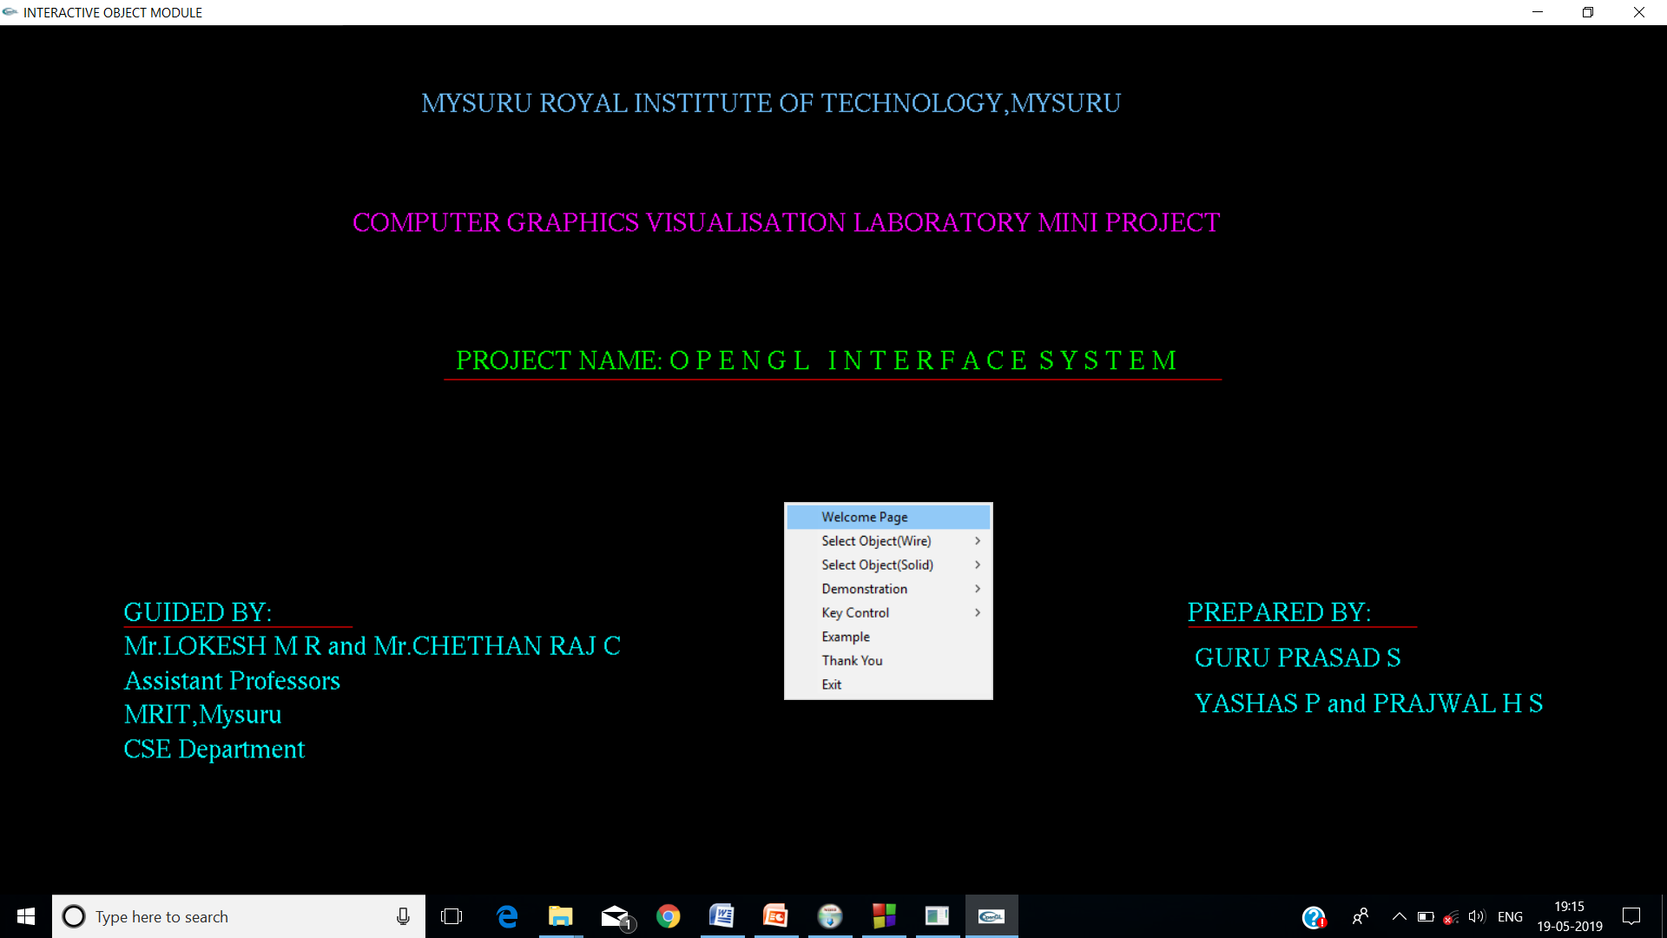
Snapshots

Slide 10
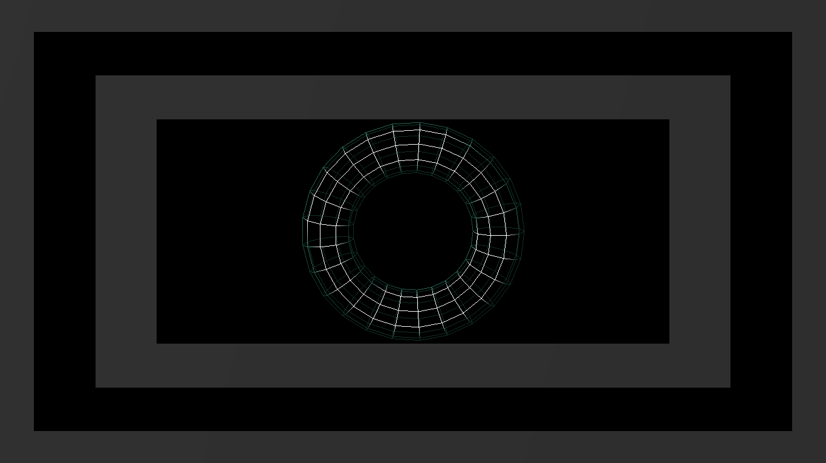
Figure , Wired Object(torus) example

Slide 11
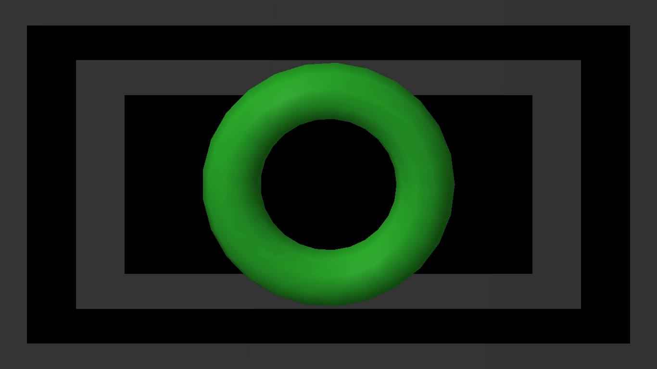
Figure Solid Object(Torus) example.

Slide 12
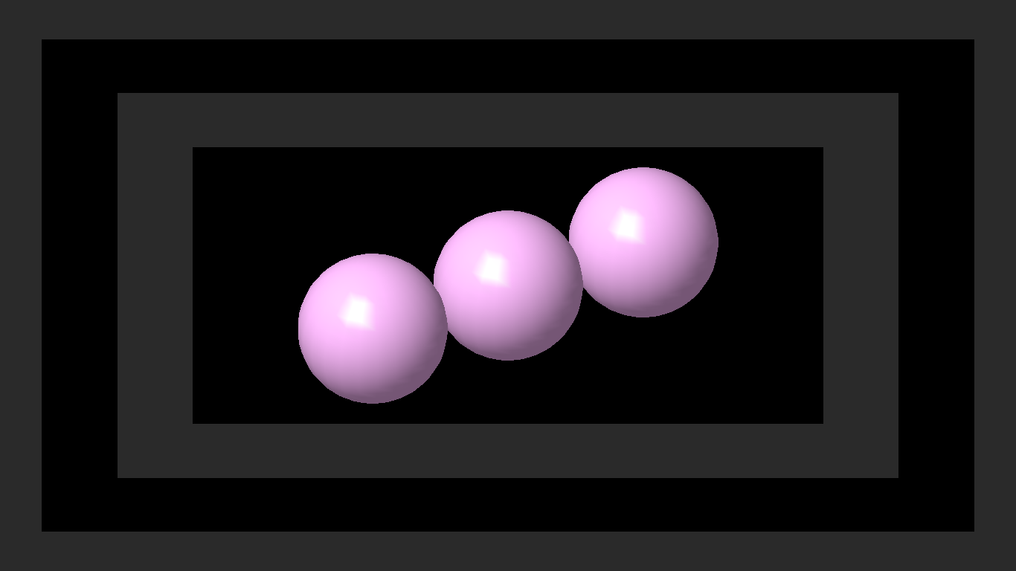
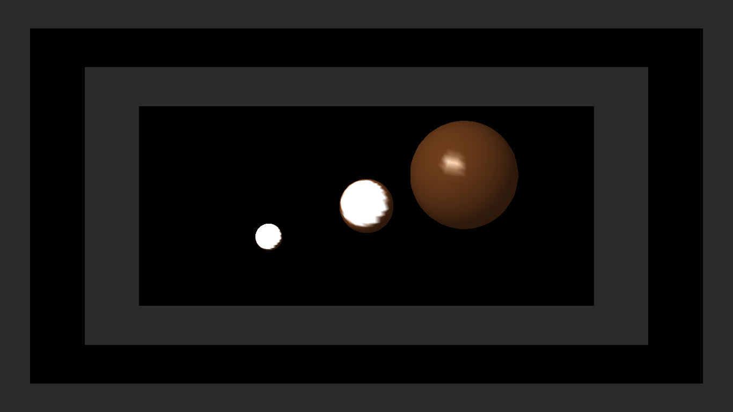
Figure Translation Demonstration.
Figure Scaling Demonstration.
Figure 8.10 Example for demonstrating all three Transformations.

Slide 13
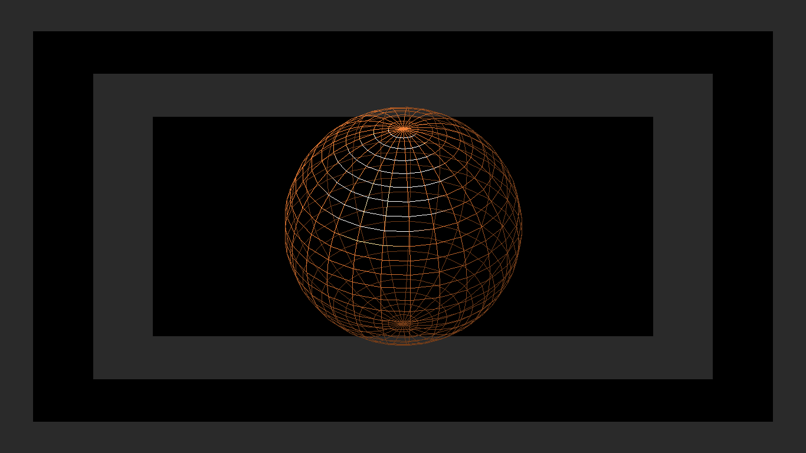
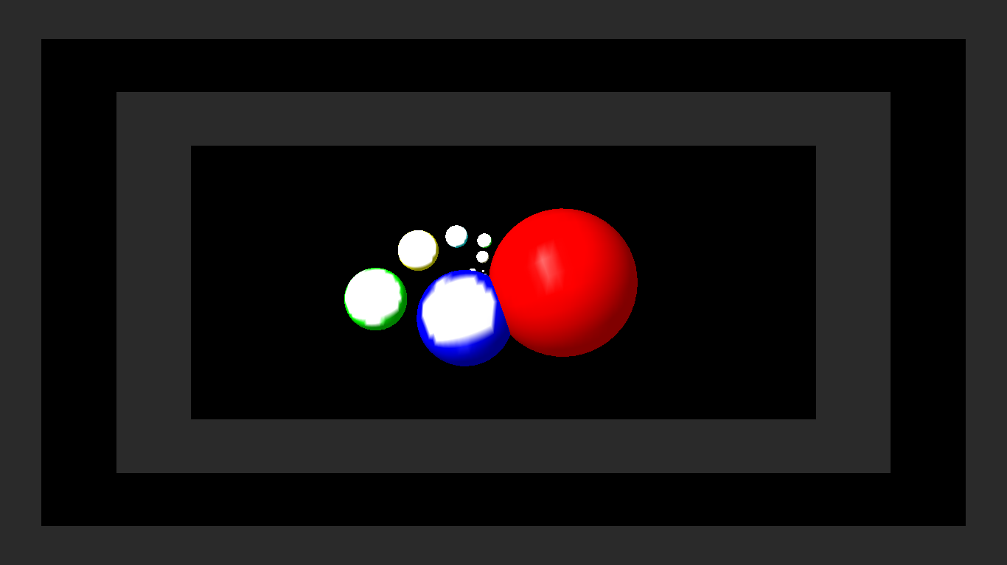
Figure Rotation Demonstration.
Figure Example for demonstrating all three Transformations.

Slide 14
Conclusion
This project was implemented using OpenGL. This project provides us the information about OpenGL Objects. This project also helps us to analyze how we can use the different standard functions for creating the animated objects and can be used for making a gaming package. This package is very useful for the users since it provides the basic information about various OpenGL functions used for creating and transforming objects.
This product has been demonstrated to fulfill the requirements. The functionality of all the modules and the module level integration is found to be satisfactory.
This project is very user friendly.
The interface is mouse driven and the user can select a function by clicking on an icon representing that function.
One of the important feature of this project is it has extracted the advantage of openGL supporting graphical concepts such as transformation and shadowing.
We have tried our level best to make this project very realistic, so that the user does not face any trouble in observing the different graphical effects when switching from one mode to other.

Slide 15
FUTURE ENHANCEMENTS
The Graphics simulator is done as a part of laboratory curriculum due to critical time constraints all features could not be implemented. Features that can be added to enhance .user friendliness and performance of graphics simulator are as follows,
Mouse Interface.
Menu based Interface
Play mode to built like a game.
Giving a try to user to create more number of objects.

Slide 16
Thank You

